Slide 1
Deploying ML model using docker - 2021
Anshu Pandey

Slide 2
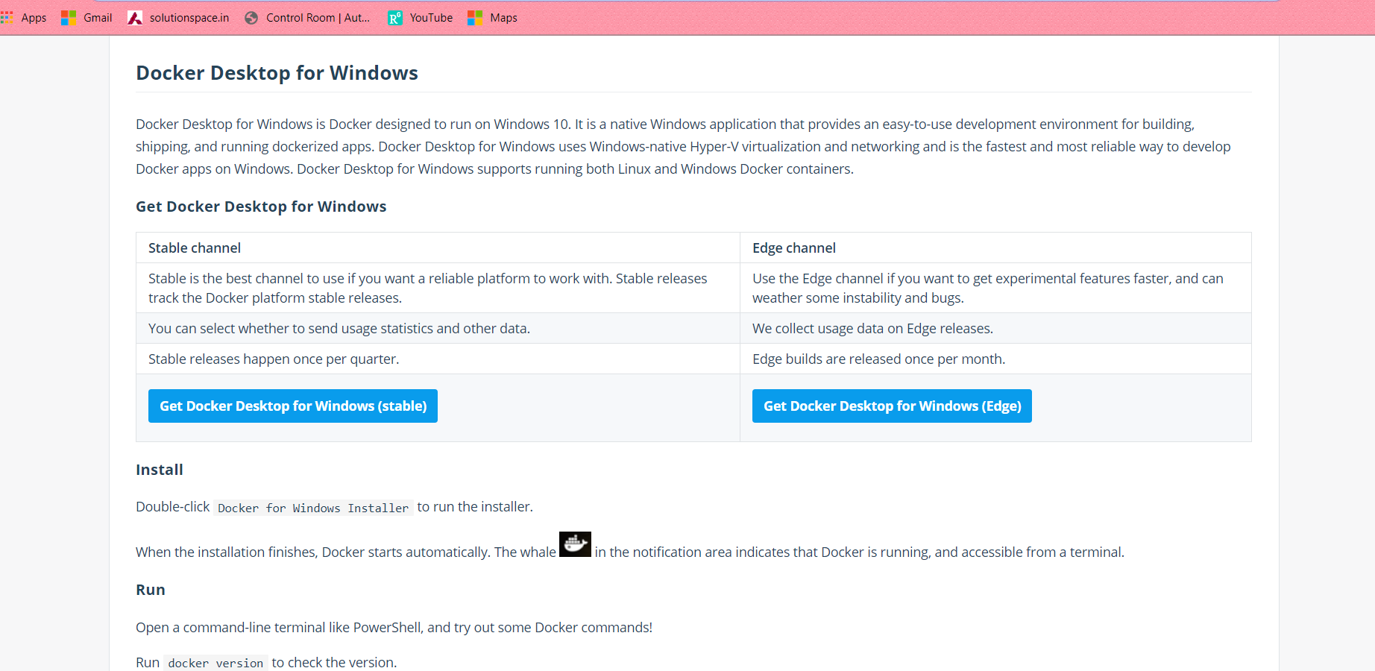
1. Download docker
Download stable version of docker from – https://hub.docker.com/editions/community/docker-ce-desktop-windows/

Slide 3
Restart mahcine

Slide 4
Download & Install linux update
https://wslstorestorage.blob.core.windows.net/wslblob/wsl_update_x64.msi

Slide 5
Create file with name – “Dockerfile”
# step 1 - mention the template for operating system and code environment
FROM python:3.7
# step2 - with in that OS we need to create a working directory to save all our codes – app
WORKDIR /app
# step3 copy files of current folder to the app folder of os
COPY . /app
#step4 - install the python libraries and packages
RUN pip install -r requirements.txt
RUN ls
# step5 - expose port 5000 and run the flask app
EXPOSE 5000
ENTRYPOINT ["python"]
CMD ["webapp.py"]s

Slide 6
Build the image
Build the docker image with name ml-model
docker build -t ml-model .

Slide 7
Run the container
Run docker container on port 5000
docker run -d -p 5000:5000 ml-model

